Slide 1



How to create a supply chain Blockchain App
Introduction
Lennart Frantzell, IBM Developer Advocate, SF
Grant Steinfeld, IBM Developer Advocate, NYC
IBM Blockchain Platform Technical Series
Technical Introduction
Using IBM Blockchain Platform
Modeling Blockchain Applications
Architectural Good Practices
What’s New in Technology
Feb 22 2020
Notes:
This is a guide on how to turn business concepts into technical concepts. Presentations in this series are:
Technical Introduction: Key concepts that make up IBM Blockchain Platform and Hyperledger Fabric
Using IBM Blockchain Platform: How to use the IBM Blockchain Platform toolset
Modeling Blockchain Applications: Turning business concepts into technical concepts
Architectural Good Practices: How to create blockchains that work well
What’s New in Technology: Recent developments in Fabric and IBM Blockchain Platform

Slide 2
Workshop level: intro
30-second pitches

Slide 3
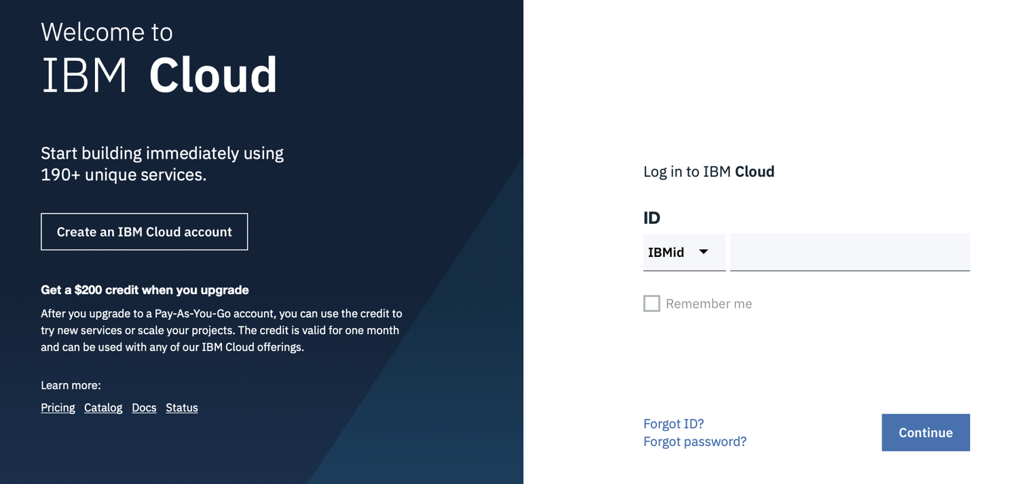
Sign up to a free IBM Cloud Account
https://ibm.biz/BdqDWA

Slide 4
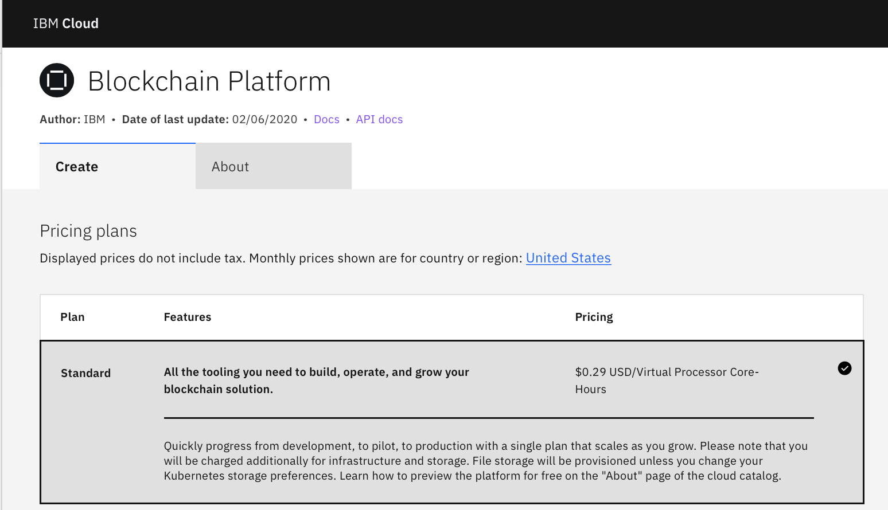
Blockchain Platform in the IBM Cloud Catalog
https://cloud.ibm.com/catalog/services/blockchain-platform

Slide 5
You can also run Hyperledger Fabric natively in Kubernetes. Free for 30 days
The IBM Blockchain Platform is based on the Hyperledger Fabric.

Slide 6
And now let’s go through the IBM Blockchain Platform architecture

Slide 7
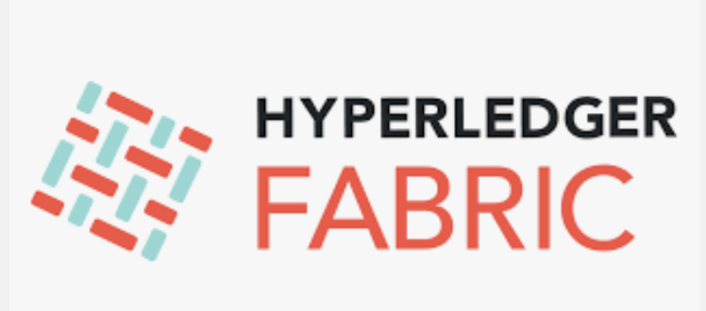
Open Source Hyperledger Fabric
Hyperledger Fabric – from The Linux Foundation – is the modular blockchain framework that has become the de facto standard for enterprise blockchain platforms.
It offers a unique approach to consensus that enables performance at scale while also preserving the data privacy enterprises demand. https://www.hyperledger.org/resources/publications/blockchain-performance-metrics
Open source and open governance
https://hyperledger-fabric.readthedocs.io/en/release-2.0/
https://www.hyperledger.org/projects/fabric

Slide 8
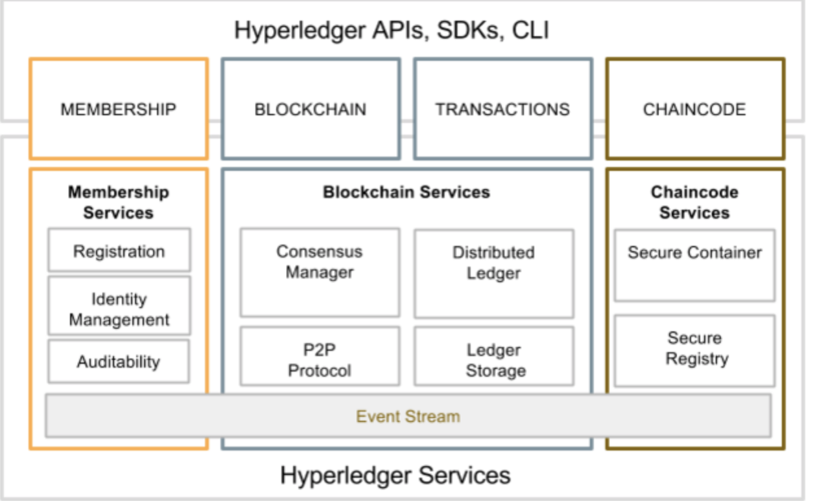
Hyperledger Fabric

Slide 9
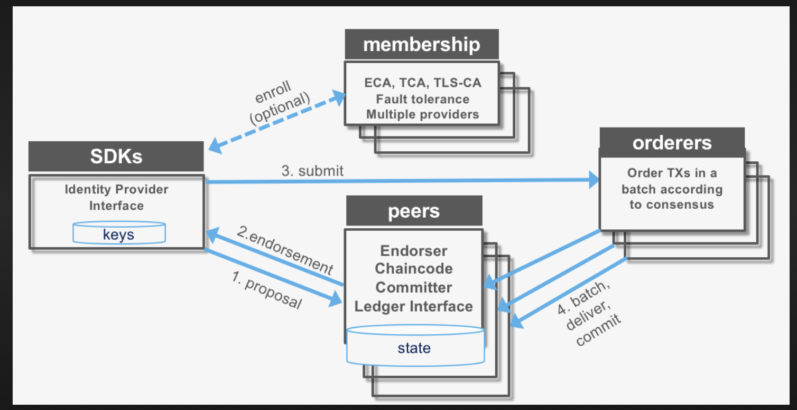
Hyperledger Fabric
Transaction Certificate Authority
TLS Transport Layer Security
ECA Enrollment Certificate
Kafka, Raft, PBFT

Slide 10
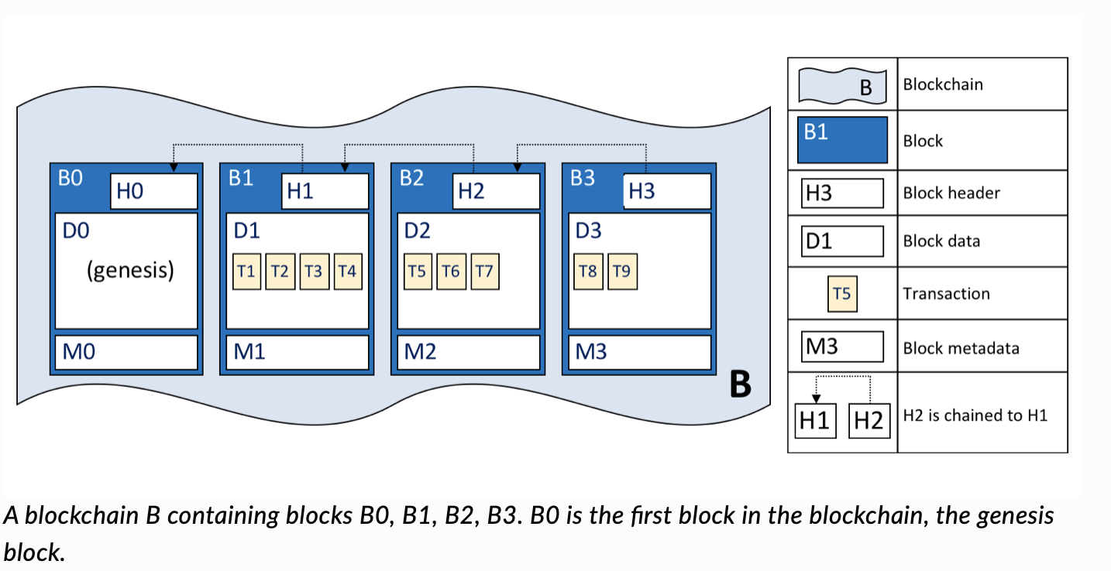
The Blockchain

Slide 11
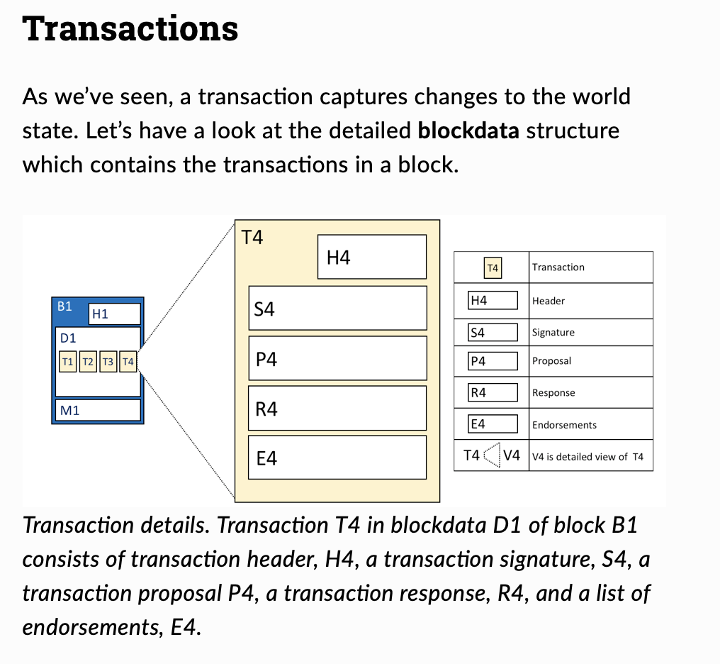

Slide 12
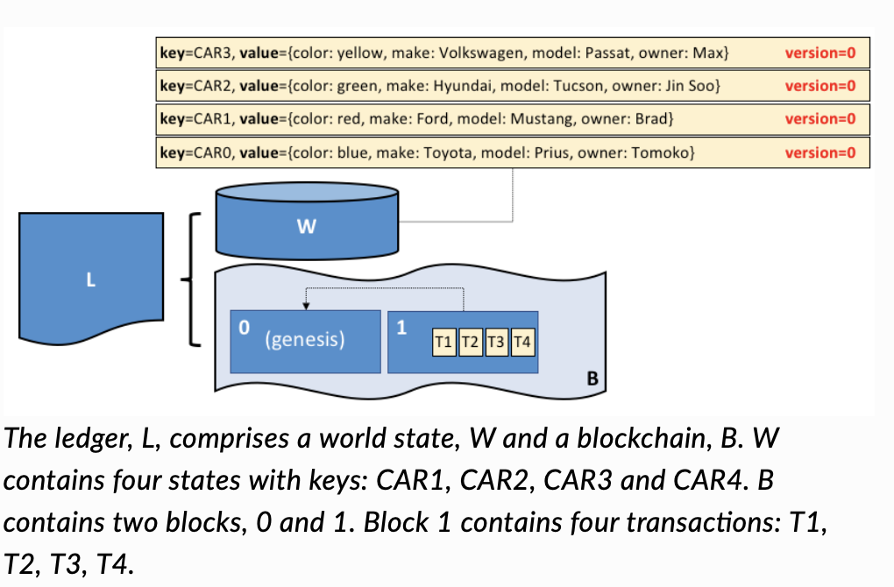
So what makes a Blockchain a Ledger?
Accounts don’t use erasers

Slide 13
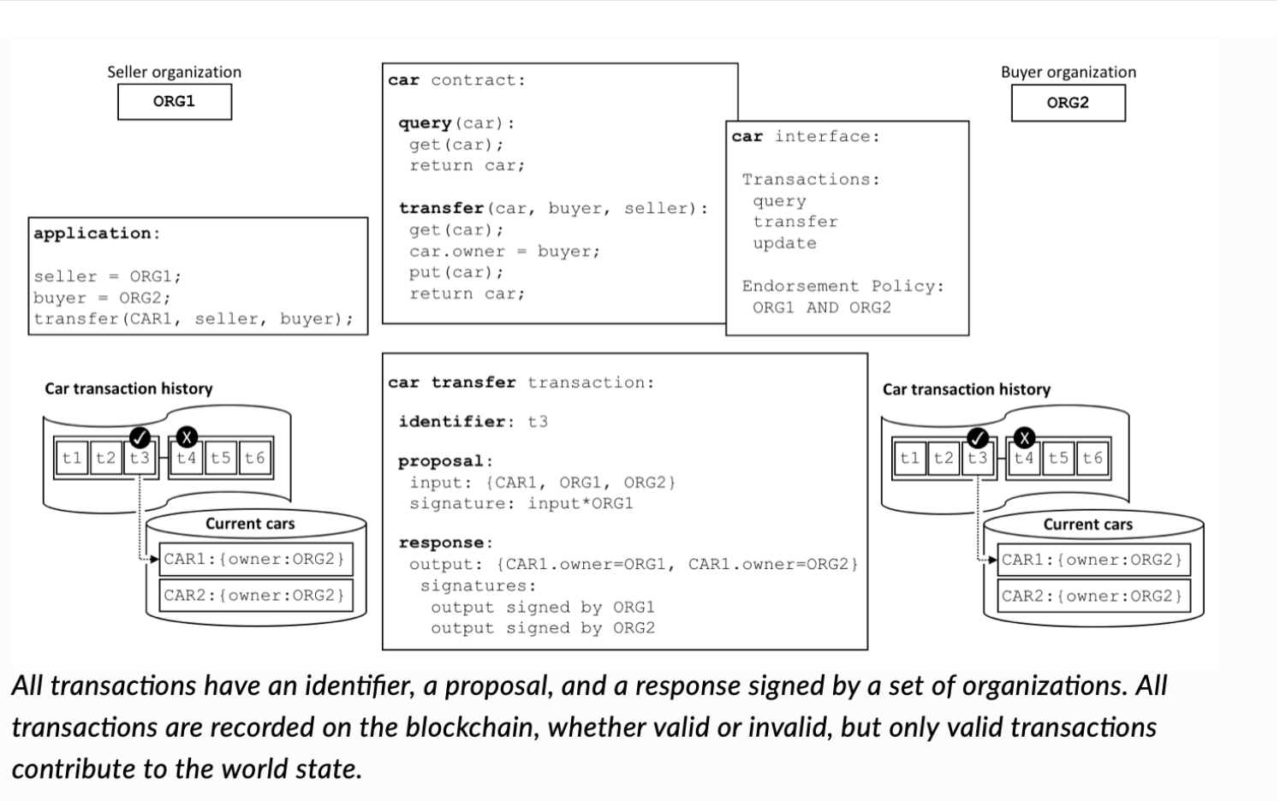
Smart Contract
Hyperledger Fabric allows users to define policies around the execution of chaincode. These endorsement policies define which peers need to agree on the results of a transaction before it can be added to the ledger.
Like Stored Procedures

Slide 14

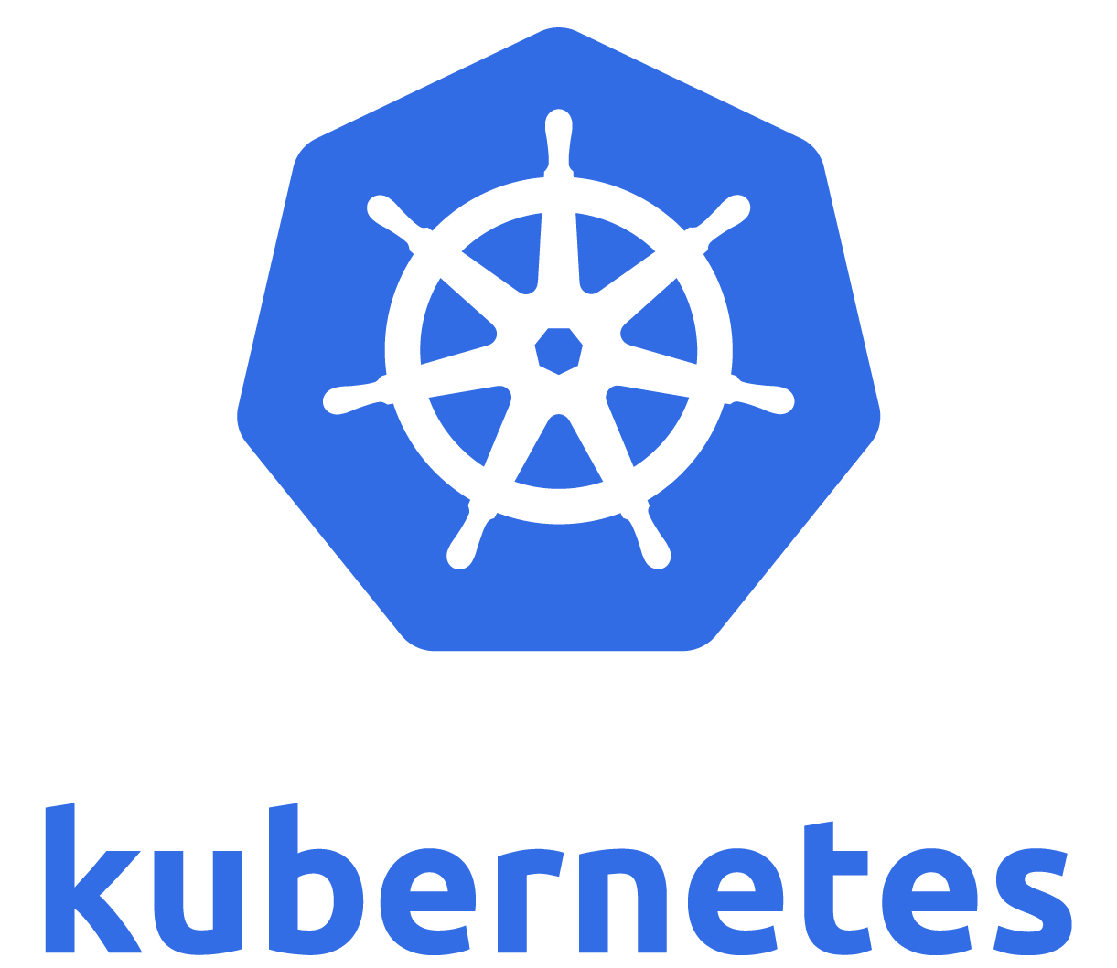

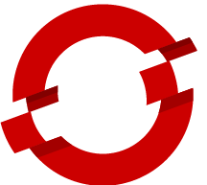


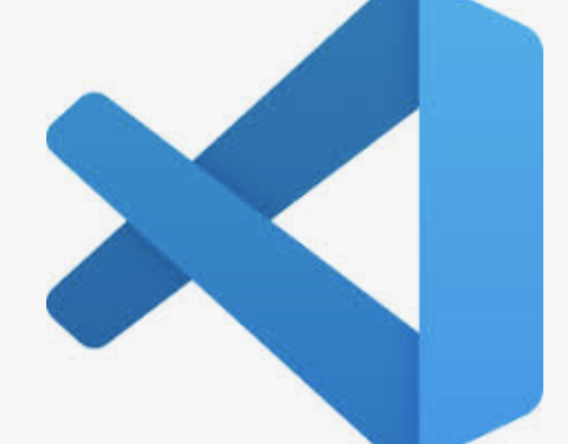
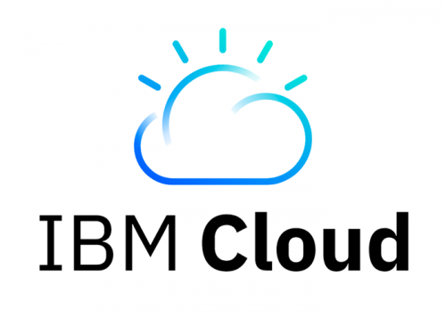
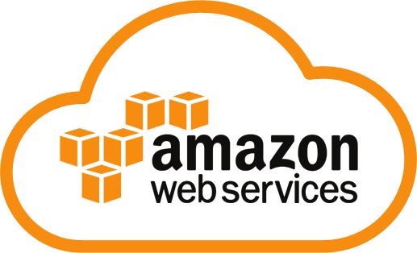
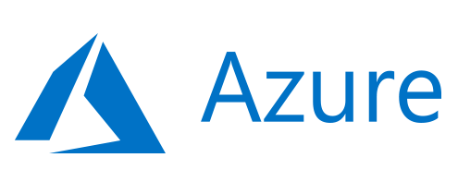
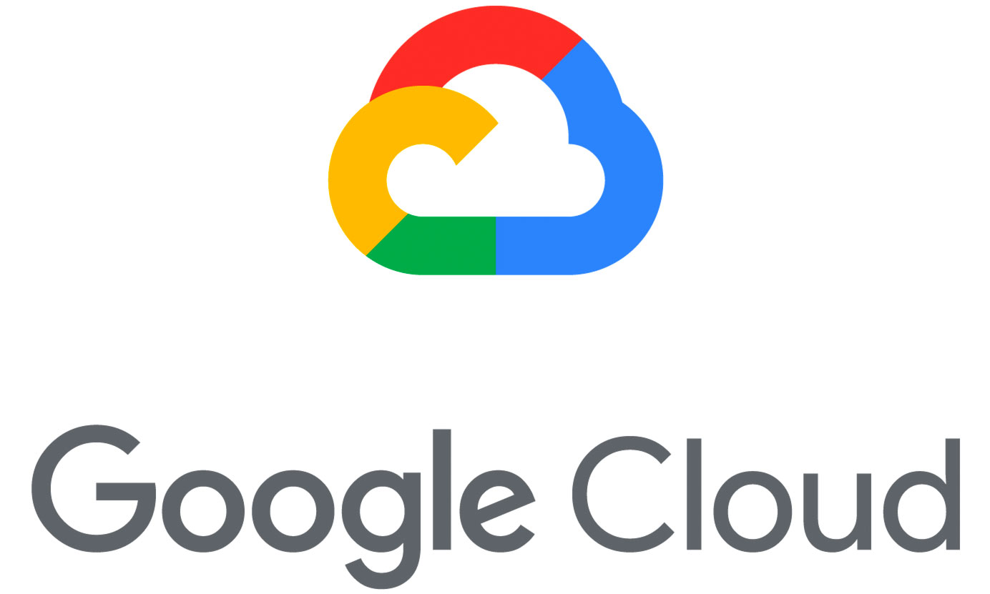
Introducing IBM Blockchain Platform v2.1.2
Build, operate and grow Hyperledger Fabric networks
Developer
tools
Operator
tools
Container virtualization & orchestration
IBM Kubernetes Service
…
on prem
Multi-cloud deployment
Advanced tooling
Create & manage smart contracts, applications & networks
Open technology
Hyperledger Fabric,
Containers, Kubernetes
Deploy anywhere
Comprehensive cloud &
on-premises options
Notes:
This is the IBM Blockchain Platform in a single chart. IBP is not just a hosting platform, but it aims to help with the entire lifecycle of a blockchain solution from inception through to deployment and beyond. The simplified architecture diagram on the right shows how the platform is put together. It’s built on the IBM Cloud platform, although other options are available, and makes use of the Hyperledger Fabric run time. There are a set of tools for solution development as well as tools to allow clients to govern and operate blockchain business networks.
IBM’s key differentiators are down the left: (a) advanced TOOLING for building, operating and growing blockchain networks, and (b) the ability to deploy blockchains ANYWHERE. (c) Of course, everything is backed by the OPEN Hyperledger Fabric technology.
The next few charts go into detail on each of these ideas.

Slide 15
IBM Blockchain Platform Deployment Options
There is just one IBM Blockchain Platform product regardless of where it is deployed
It sits on a Kubernetes container infrastructure on your chosen provider
Kubernetes provides common logging and management services of the IBM Blockchain Platform
When run on IBM Cloud, the IBM Blockchain Platform uses the IBM Cloud Kubernetes Service
Use the free IBM Kubernetes tier for a free IBM Blockchain Platform, or a paid IBM Kubernetes tier for a paid IBM Blockchain Platform; free tiers expire after 30 days
When deployed on-premises or on any non-IBM cloud, IBM Blockchain Platform deploys to Kubernetes v1.11
Examples include OpenShift, OKD, Rancher & AEKS
Notes:
VSCode image credit: en.wikipedia.org

Slide 16
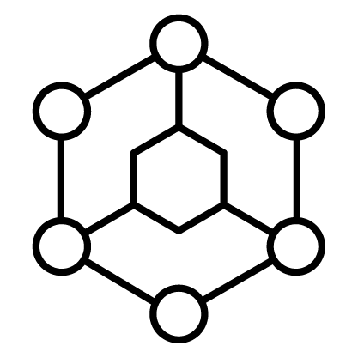
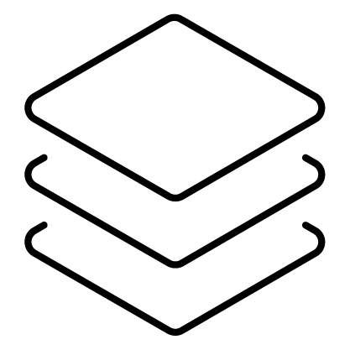
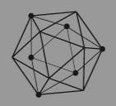

IBM Blockchain Platform is a key part of IBM’s Blockchain Strategy
Tap into our diverse ecosystem to develop strategic partnerships and create your competitive advantage
Ecosystem
Services
Solve critical industry challenges by building and joining new business networks and applications
Solutions
Collaborate with services teams from ideation all the way to production
Build, operate and grow blockchain networks in heterogeneous environments
IBM Blockchain Platform
A founding, premier member of Hyperledger, IBM is committed to open source, standards & governance
Notes:
This is an overview on IBM’s general strategy for blockchain. The foundation of everything is IBM’s continued participation in the Hyperledger project. On top of that we have the IBM Blockchain Platform that allows business networks to develop, govern and operate blockchains. The solutions on top of that include everything that IBM has developed, and continues to develop for solving particular industry needs - such as food trust. Finally, in order to scale we will need to nurture an effective ecosystem of business partners. Critical to all of these aspects is a services capability that can help make blockchain a success for clients.

Slide 17
Supply Chain and Blockchain
Poster Child

Slide 18

Introducing IBM Food TrustTM built on Blockchain technology
Efficiency
The IBM Food Trust solution is a set of modules providing traceability to improve food transparency and efficiency
Blockchain is used to create a trusted connection with shared value for all ecosystem participants, including end consumers
The solution offers connectors for interoperability and leveraging existing standards (e.g., GS1)
Blockchain properties come together to create a more trusted, transparent, and efficient data-sharing platform.
Distributed Ledger
Digital Transactions
Trust
Transparency
Immutable Data

Slide 19

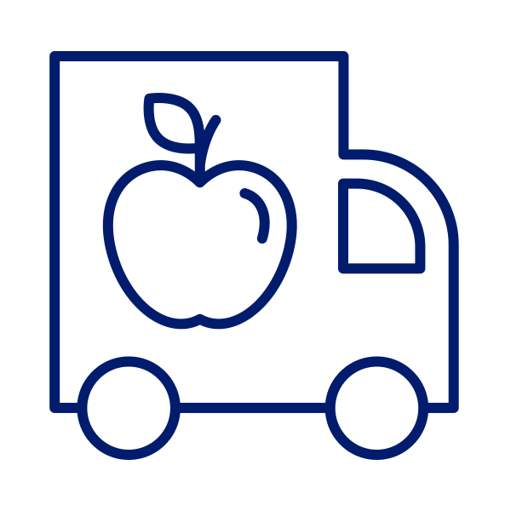



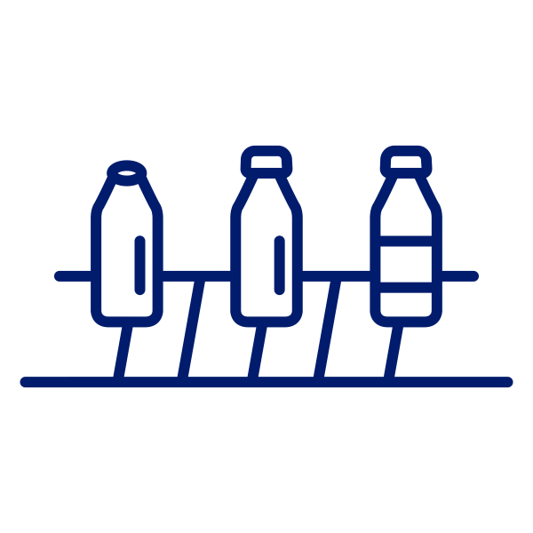
Today, traditional system constructs limit transparency
The Problem:
Data is siloed within each company and accessing it requires a request and time
Exchange of information takes place between a pair of partners; to get information from a distant partner may require intermediaries, time, resources
Most transactions are still paper-based, creating inefficiencies and opportunities for fraud
Because everyone maintains their own record of transactions, differences take time and resources to reconcile
The food industry today
Restaurant
Logistics
Retailer
Grower
Inputs
Manufacturer

Slide 20
Blockchain transforms systems with trust and transparency
The food industry with blockchain
The Solution:
Because blockchain provides an independent data-sharing platform, participants trust it
Once data is shared in a single data-sharing platform, everyone has instant transparency into the transactions they are authorized to view; no intermediation required
Data immutability creates an auditable record of all transactions, disincentivizing fraudulent behavior
Dispute resolution from the shared ledger can be automated saving time and resources
Restaurant
Retailer
Logistics
Grower
Manufacturer
Inputs

Slide 21
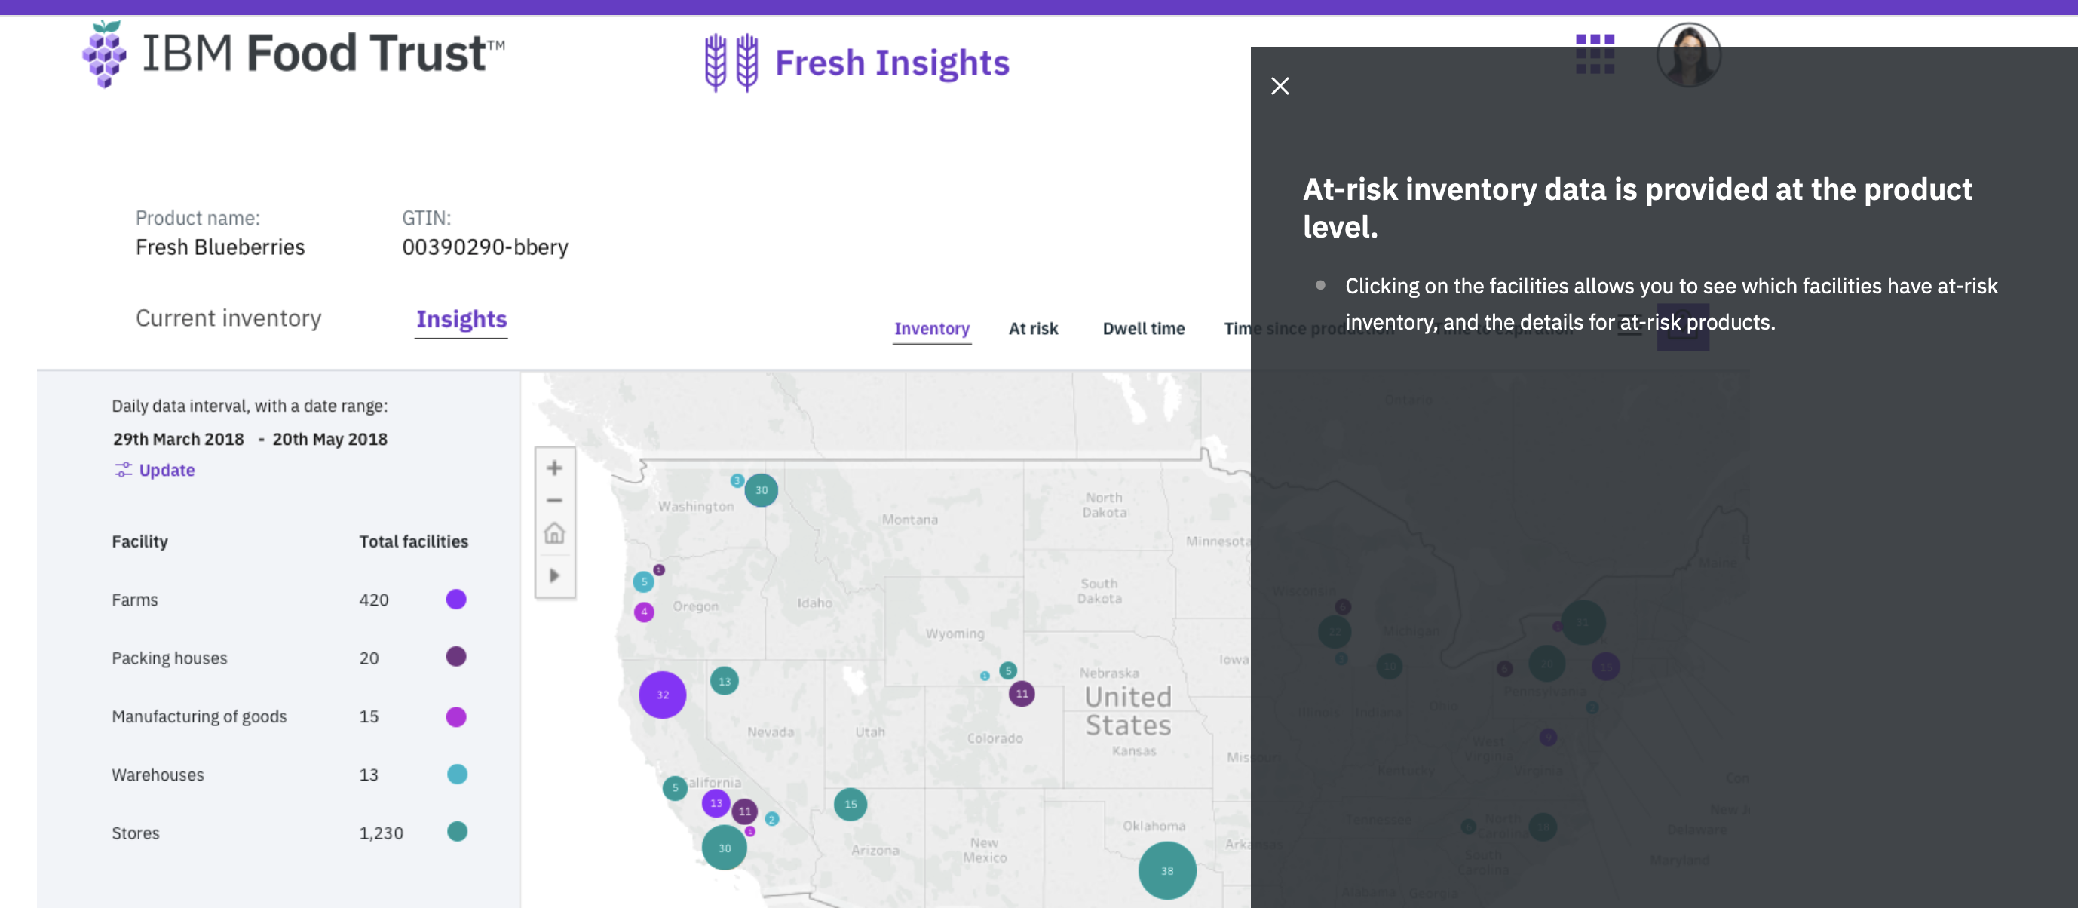

Slide 22
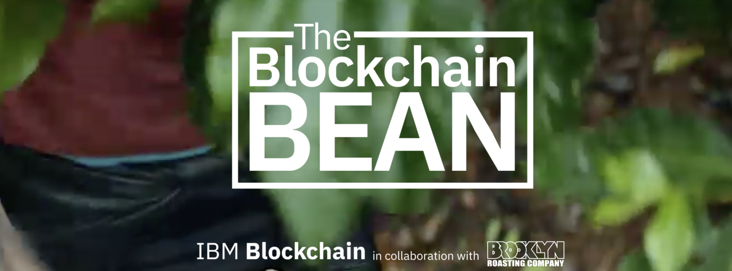
Coffee and Blockchain

Slide 23
Let’s get coding!

Slide 24
Blockchain for coffee scenario, Agile process
Two participants: a grower, a roaster
Later on you’ll add on the other participants: the shipper and the coffee shop

Slide 25
Development tools and Installation
The current workshop uses all cloud components, no installation is necessary. After the workshop, you will need to install the following products:
Visual Studio Code: https://code.visualstudio.com
Followed by the Visual Studio Platform plug-in: https://bit.ly/2RS2R02
An account on the IBM Cloud: https://www.ibm.com/cloud
Followed by the signing up to the IBM Blockchain Platform Service: https://ibm.co/398sxeT

Slide 26
VS Studio Code
August 2019 (version 1.38)
https://code.visualstudio.com/updates/v1_38

Slide 27
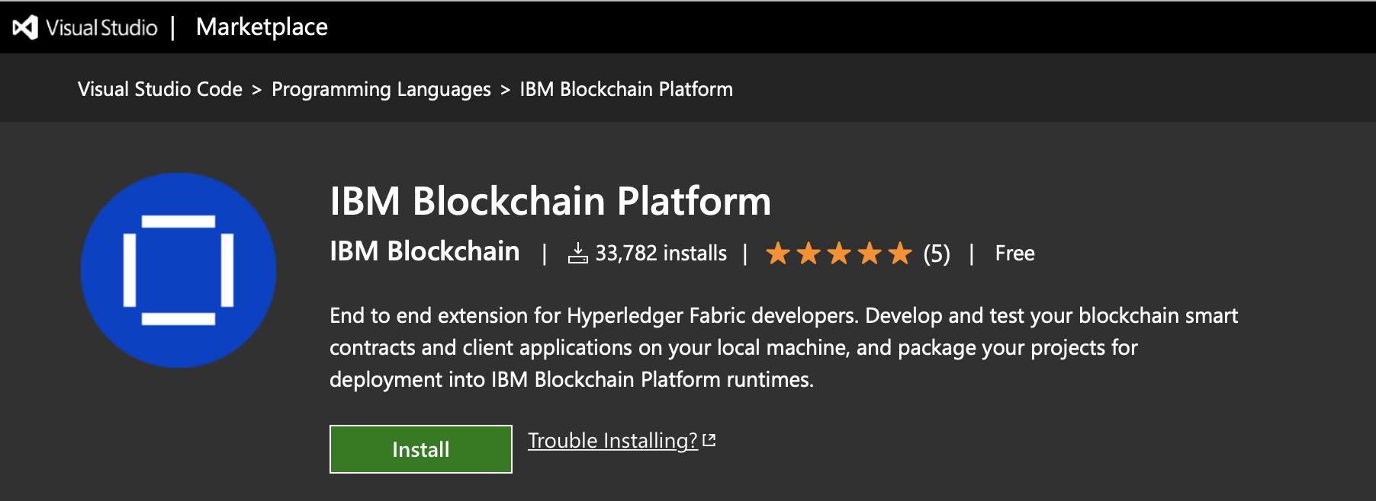
VSCode Extension
https://bit.ly/2RS2R02

Slide 28
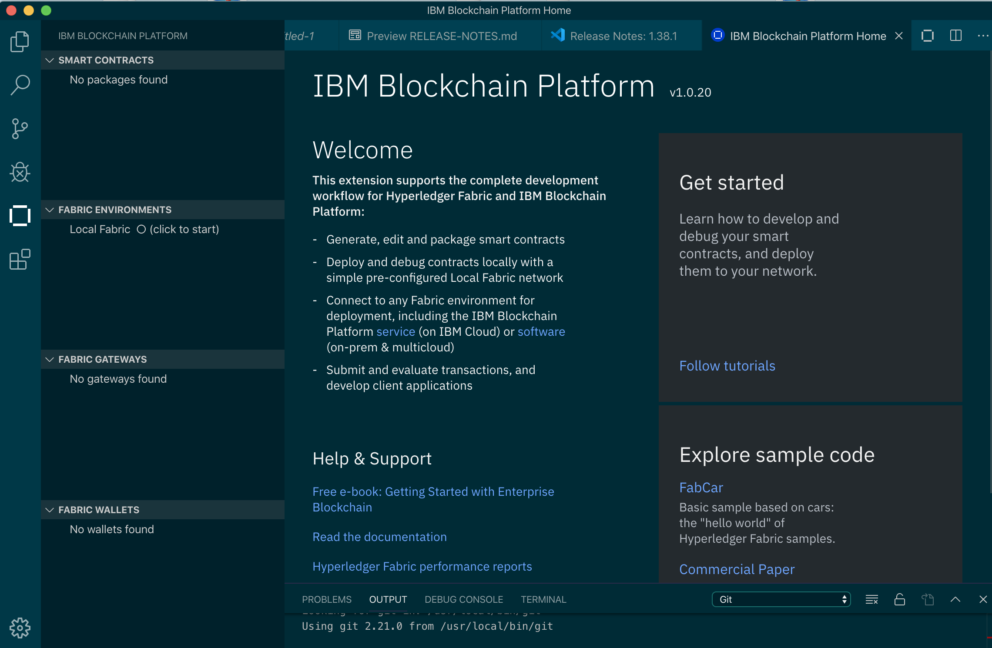
VS Studio Code with VS Code extension

Slide 29
Additional Materials
IBM Blockchain 101: https://ibm.co/36U1QZM
Blockchain code patterns: https://ibm.co/2GROsL0

Slide 30
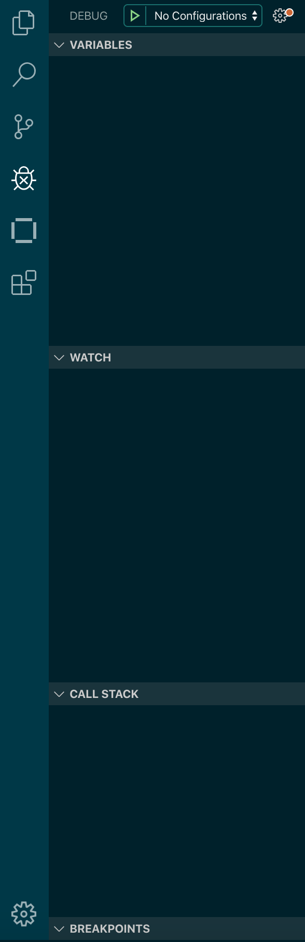
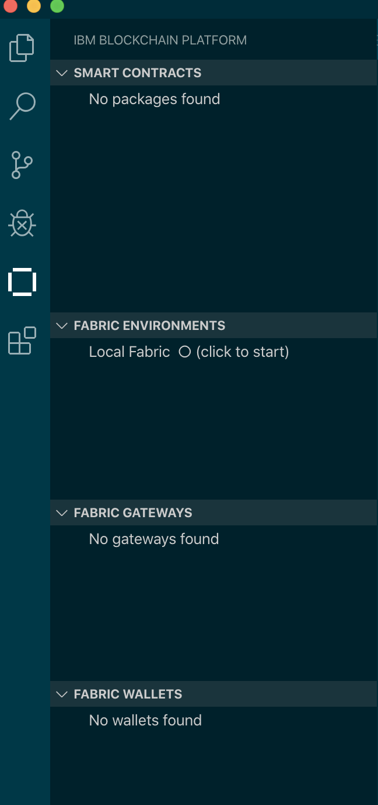
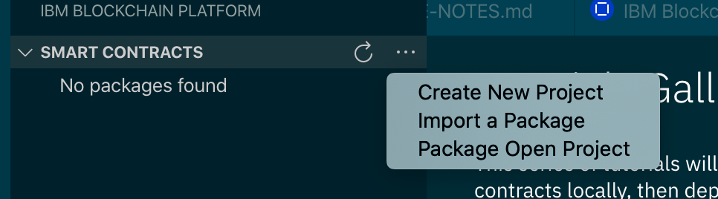
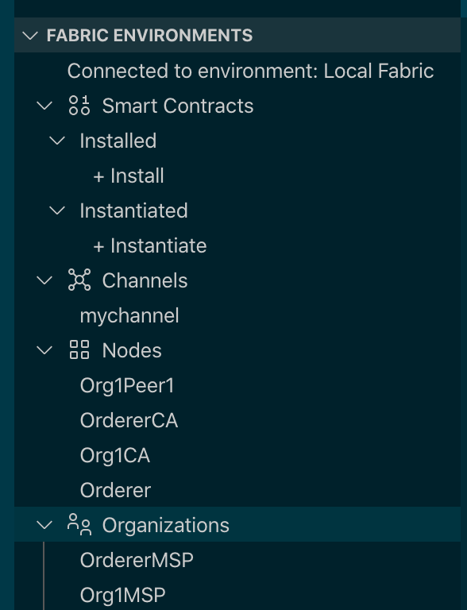
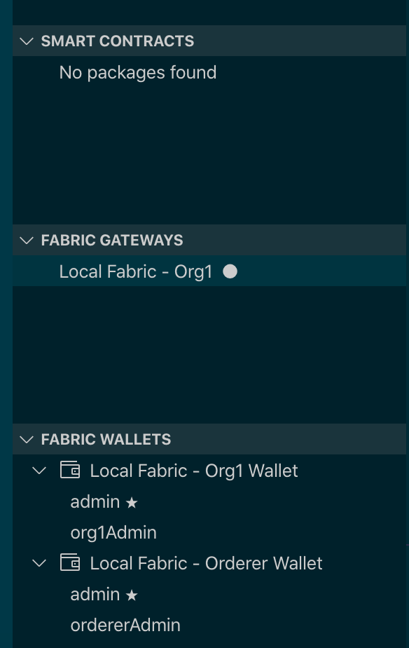
VSCode Layout

Slide 31
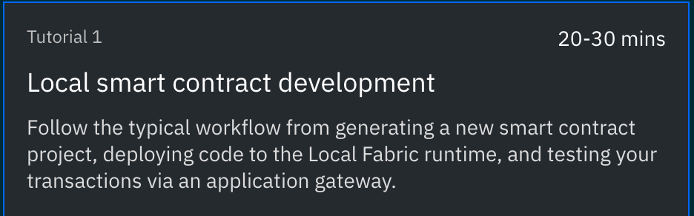
Lab 1

Slide 32
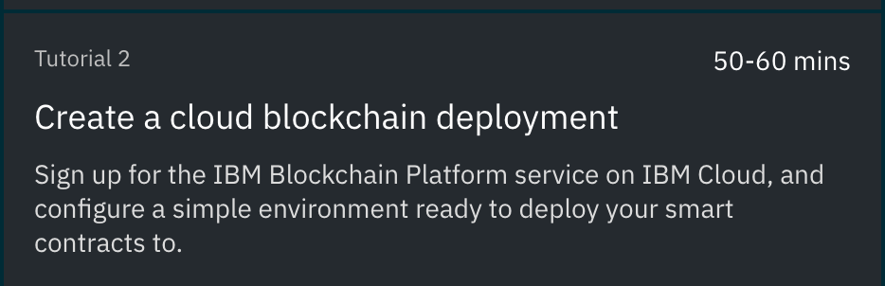
Lab 2

Slide 33
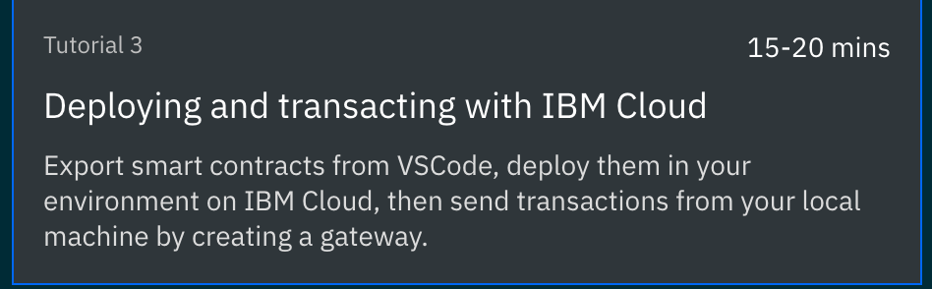
Lab 3, stretch goal.

Slide 34
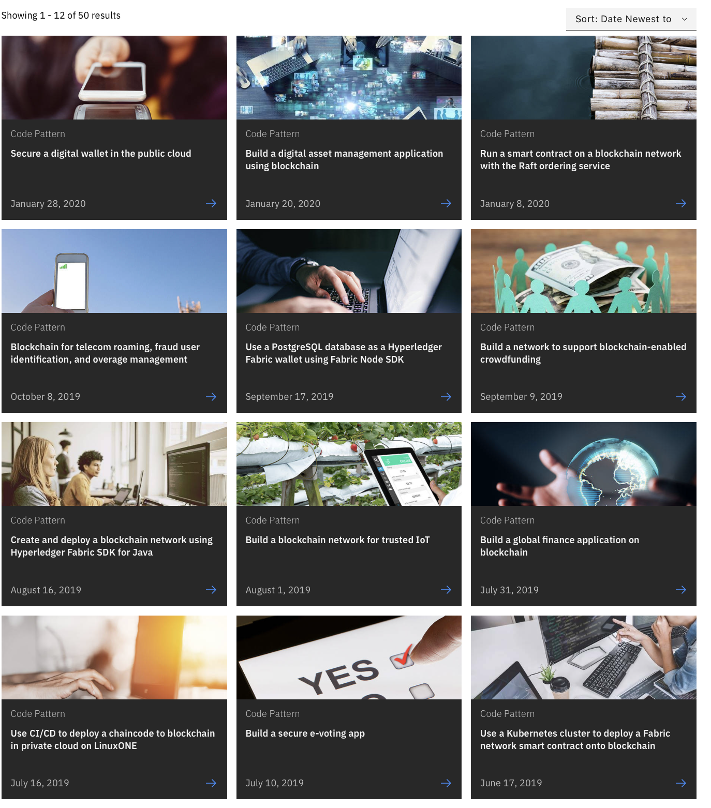
Additional labs.
Blockchain Bean 2:
https://github.com/IBM/blockchainbean2
Blockchain code patterns
https://developer.ibm.com/patterns/category/blockchain/

Slide 35
Thank you
Lennart Frantzell
Grant Steinfeld
www.ibm.com/blockchain
developer.ibm.com/blockchain
www.hyperledger.org
© Copyright IBM Corporation 2019. All rights reserved. The information contained in these materials is provided for informational purposes only, and is provided AS IS without warranty of any kind, express or implied. Any statement of direction represents IBM's current intent, is subject to change or withdrawal, and represents only goals and objectives. IBM, the IBM logo, and other IBM products and services are trademarks of the International Business Machines Corporation, in the United States, other countries or both. Other company, product, or service names may be trademarks or service marks of others.

Slide 36
Housekeeping
VCPI link SF: https://ibm.biz/BdqDWA
Whitelisting: https://cloud.ibm.com/registration/whitelist
IBM Careers: https://careers.ibm.com
IBM Partner world: https://www.ibm.com/partnerworld/public
Sign up to the IBM Cloud: https://ibm.biz/BdqDWA
https://cloud.ibm.com/registration?cm_mmc=Email_Events-_-Developer_Innovation-_-WW_WW-_-advocates:alf,max-katz\title:howtocreateasupplychainblockchainapp\eventid:5e2f89bbb1889fcaca174d52\date:Feb2020\type:workshop\team:global-devadvgrp-sanfrancisco\city:santaclara\country:unitedstates\tags:blockchain\contents:blockchain-disaster-management-solution&cm_mmca1=000019RS&cm_mmca2=10004805&cm_mmca3=M99938765&eventid=5e2f89bbb1889fcaca174d52&cvosrc=email.Events.M99938765&cvo_campaign=000019RS

Slide 37
Whitelisting
Whitelisting: https://cloud.ibm.com/registration/whitelist
If you are whitelisting a VCPI code, please only enter everything after cm_mmc= until the first &.
Email_Events-_-Developer_Innovation-_-WW_WW-_-advocates:alf,max-katz\title:howtocreateasupplychainblockchainapp\eventid:5e2f89bbb1889fcaca174d52\date:Feb2020\type:workshop\team:global-devadvgrp-sanfrancisco\city:santaclara\country:unitedstates\tags:blockchain\contents:blockchain-disaster-management-solution

Slide 38
Event format
Two hour workshop on 2/24 NYC and 2/27 SF
Intro, presentation 30 minutes
Workshop 1 hour using new IBM OpenLabs environment
Wrapup 30 minutes
Notes:
What we’ve covered in this session.

Slide 39
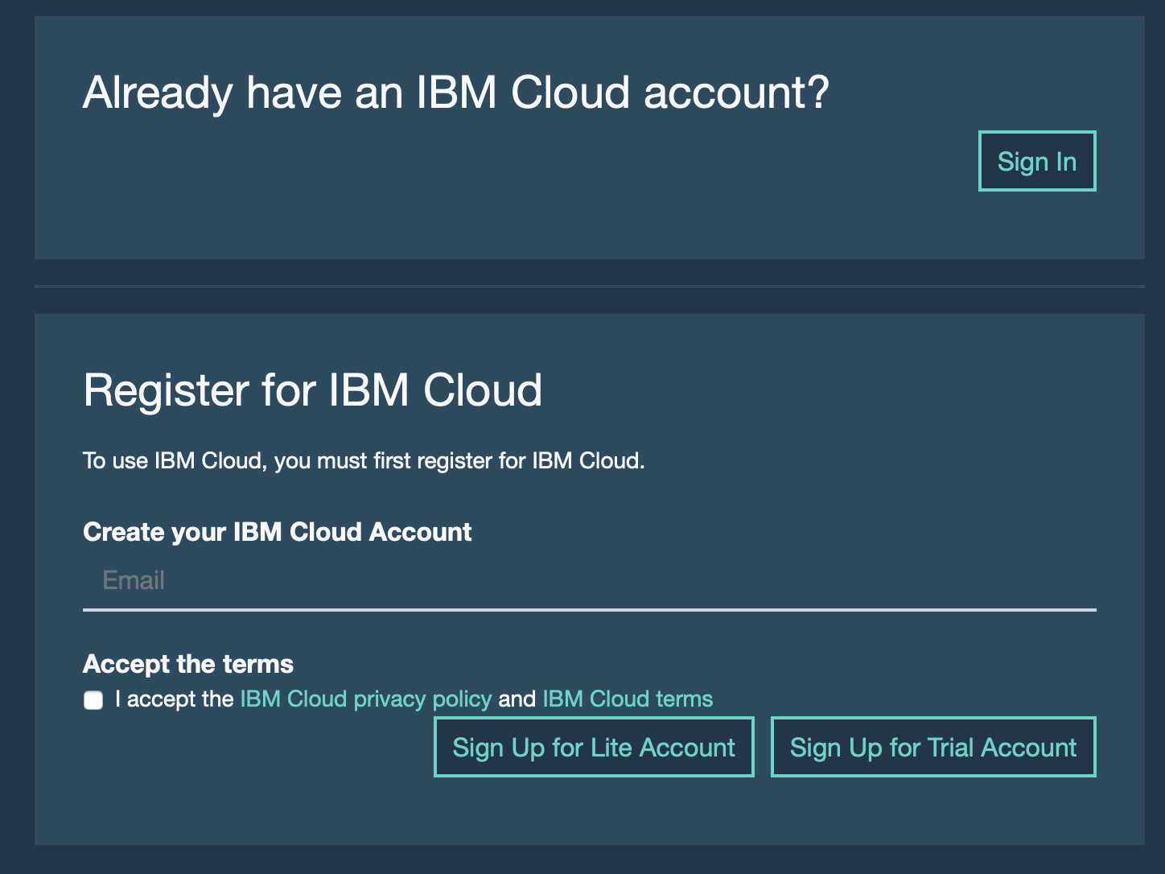
Sign-up for IBM OpenLabs account
https://developer.ibm.com/openlabs/event/IBP-EVENT-DEMO

Slide 40
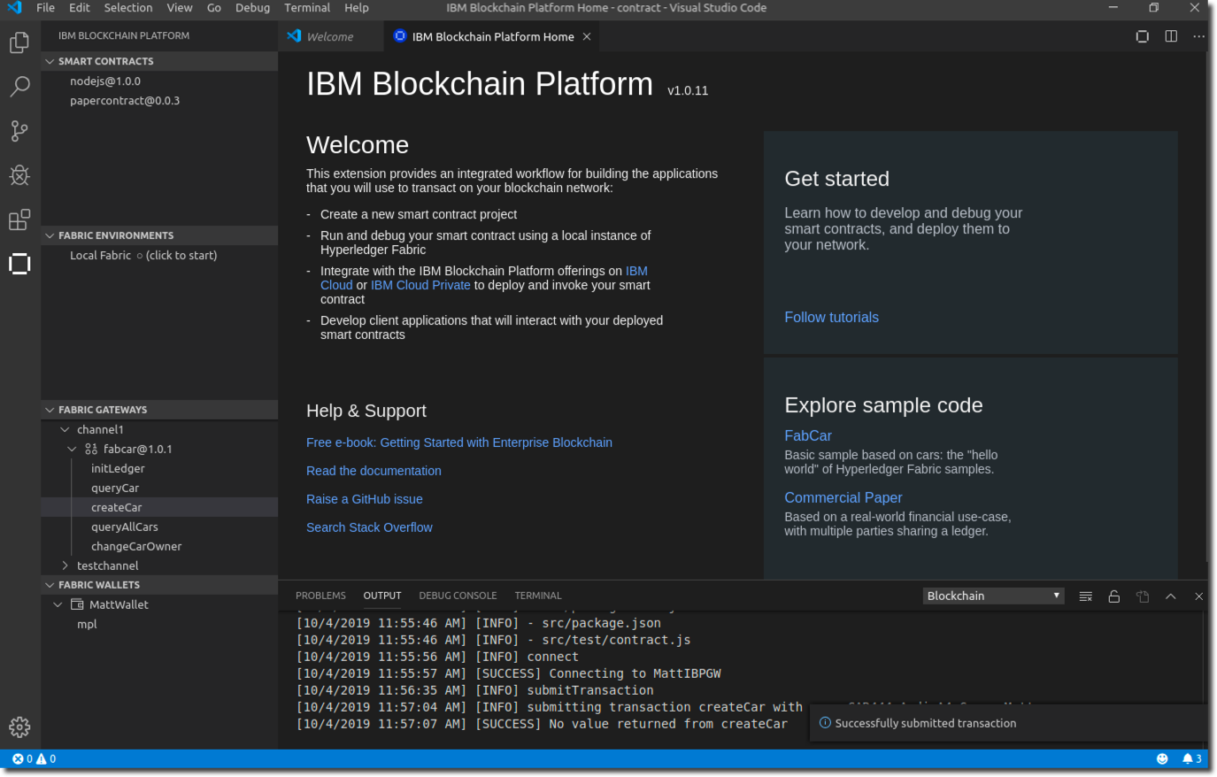
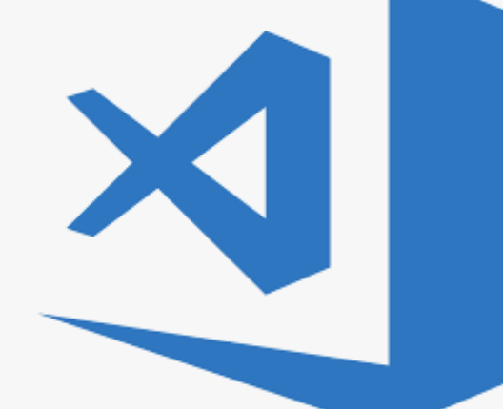
Getting Started with Hyperledger Fabric
The IBM Blockchain Platform makes it easy to get started with Hyperledger Fabric
Download VSCode developer tool from VSCode marketplace. Linux, Windows and MacOS)
Create local networks, smart contracts and applications. Move to multi-cloud when you're ready!
https://marketplace.visualstudio.com/items?itemName=IBMBlockchain.ibm-blockchain-platform

Slide 41
IBM Blockchain Platform Admin Console
Multi-cloud administration tool
Web UI to manage all IBP components
Configure infrastructure on IBM Cloud
Configure IKS network, storage, compute
Connect & Manage components
Peer, Orderer, CA, channel...
Policy & Identity management
Create, update, display channel policies
Smart contract package management
Install, instantiate, upgrade, discover

Slide 42
Blockchain Videos
https://developer.ibm.com/technologies/blockchain/videos/

Slide 43
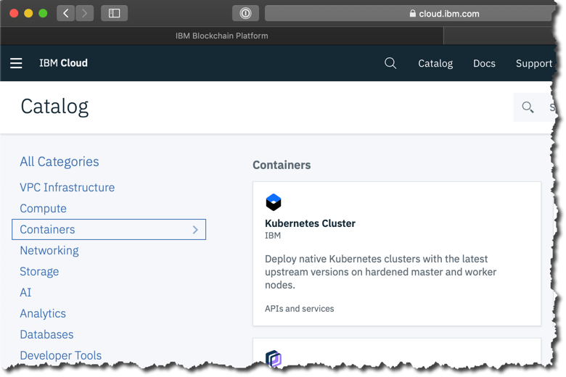
On IBM Cloud, your blockchain components are deployed to an IBM Kubernetes service
Blockchain resources are deployed into your own Kubernetes cluster
This allows you to maintain control over your resources (CPU, storage, memory)
Scale up or down as required for your blockchain environment
Start small, pay as you grow for what you use with no upfront investment
Maintain control of private keys

Slide 44
Deployment Overview: IBP & IKS & Storage
Your Blockchain Service
Your Infrastructure Resources
IBM Blockchain Platform
The instance that lets you deploy and manage your Hyperledger Fabric nodes.
Operational Console (UI)
Hyperledger Fabric Components
Certificate Authority
Peer
Ordering Service
Containers
CA
Peer
Couch
Orderer
GRPC-Web
Chaincode
Init
Init
Init
Fluentd
GRPC-Web
IBP VS Code extension (Development Tools)
Learn more: https://cloud.ibm.com/docs/containers?topic=containers-ibm-cloud-kubernetes-service-technology

Slide 45
Deployment Overview: IBP & IKS & Storage
Your Blockchain Service
Your Infrastructure Resources
IBM Blockchain Platform
The instance that lets you deploy and manage your Hyperledger Fabric nodes.
IBM Cloud Kubernetes Service
Your compute and memory that you allocate to your blockchain instance
Operational Console (UI)
Cluster (e.g. 2CPU x 4GB RAM)
Hyperledger Fabric Components
Worker Node
Pod
Certificate Authority
Peer
Ordering Service
Containers
App (Containers)
CA
Peer
Couch
Orderer
GRPC-Web
Chaincode
Init
Init
Init
Fluentd
GRPC-Web
Persistent Storage
IBP VS Code extension (Development Tools)
File Storage (Default)
Learn more: https://cloud.ibm.com/docs/containers?topic=containers-ibm-cloud-kubernetes-service-technology

Slide 46
Deployment Overview: IBP & IKS & Storage
Your Blockchain Service
Your Infrastructure Resources
IBM Blockchain Platform
The instance that lets you deploy and manage your Hyperledger Fabric nodes.
IBM Cloud Kubernetes Service
Your compute and memory that you allocate to your blockchain instance
Operational Console (UI)
Cluster (e.g. 2CPU x 4GB RAM)
Each Fabric component is deployed into an individual Pod
Hyperledger Fabric Components
Worker Node
1
2
3
3
Pod
Certificate Authority
Peer
Ordering Service
1
2
Containers for each component are within the Kubernetes Pod and can be managed as standalone items
App (Containers)
Containers
CA
Peer
Couch
Orderer
CPU & Memory
GRPC-Web
Chaincode
Init
Init
Init
Fluentd
GRPC-Web
Storage
Persistent Storage
IBP VS Code extension (Development Tools)
File Storage (Default)
Learn more: https://cloud.ibm.com/docs/containers?topic=containers-ibm-cloud-kubernetes-service-technology

Slide 47
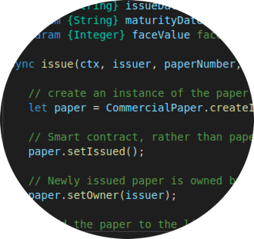
Summary
The Hyperledger Fabric transaction
Structure drives system design and application architecture
Smart contract
Contains transaction definitions for entire lifecycle of business object(s) stored in a decentralized ledger
built-in contract class makes programming easy
Application
Consensus is complex, but the SDK makes it easy for applications
submitTransaction(), evaluateTransaction(), addListener()
gateway connectionOptions for ultimate customizability
The IBM Blockchain Platform difference
Multi-cloud networks, developer & operator tools, IBM service and support

